Slide 1
DIRECTED ACYCLIC GRAPHS
USING APACHE SPARK
Team 7
Monodeep Kar, Vinish Chamrani, Akshay Phadke, Daniel Morton, Dylan Slack, Zeheng Chen

Slide 2
PROBLEM DEFINITION
We used Directed Acyclic Graphs in Apache Spark in order to make song recommendations from a current song.
Used MapReduce, Machine Learning, and Content Based filtering for song recommendation.
Recommended items to user similar to previous items the user listened to.
Example: Recommend songs with same singer(s), genre, etc.

Slide 3
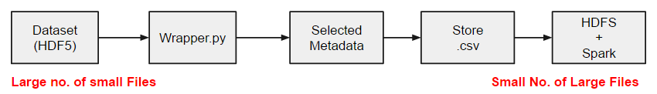
“MILLION SONG” DATASET
Available at labrosa.ee.columbia.edu/millionsong/pages/getting-dataset
It is a distributed database of size of about 300 GB
We worked on the subset of given database “Million Song Subset” which contains information of about 10,000 songs which is about 1.8 GB in size.
The dataset itself is in the HDF5 file format and comes with various wrappers to retrieve data from this file format.
A versatile data model that can represent very complex data objects and a wide variety of metadata.
Using a Python wrapper which searches through the directory to find all files with extension .h5, we retrieved some of the required metadata from the entire subset and stored it as CSV file.

Slide 4
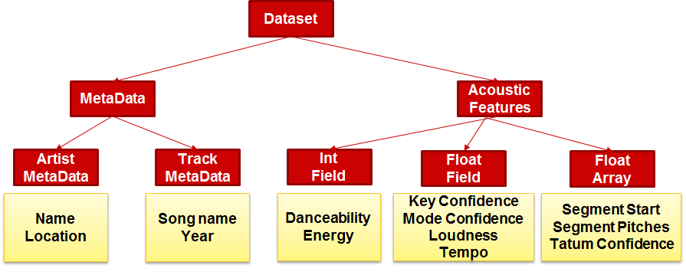
SELECTING SONG FIELDS
The dataset has about 55 fields of metadata out of which we identified following for our purpose of song recommendation:

Slide 5
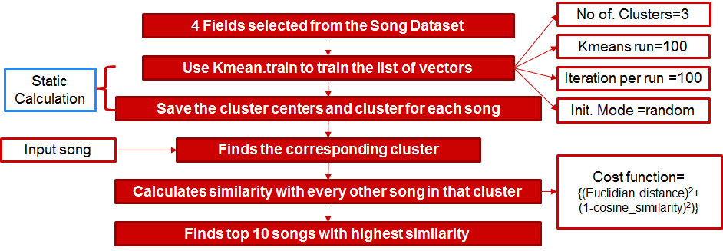
MACHINE LEARNING IMPLEMENTATION
A vector of 4 fields (key confidence, mode confidence, loudness and tempo) is used to cluster the data
K-means clustering is achieved through Spark MLIib

Slide 6
ARCHITECTURE
EC2
Input
API
Batch processing
Spark
Mongo DB
ExpressJS
(NodeJs)
3rd Party Dev
Front End

Slide 7
GENERATING TOP 10 LISTS
MapReduce was used to compute the following things based on the Million Song Subset:
For the song being queried, return the top 10 artists of the same year
For the song being queried, return the top 10 songs of the same year
STEPS
step1=sc.textFile("file:///home/ubuntu/output_csv.csv")
step2=step1.map(lambda line: line.split(",")).filter(lambda line: len(line)>1)
step3=step2.map(lambda line: ((str(line[1].encode('utf-8')),str(line[0].encode('utf-8')))))
step4=step2.map(lambda line: ((line[1].encode('utf-8'),line[0].encode('utf-8'),float(line[4]),int(line[9])))).distinct()
step5=step4.filter(lambda line: line[3]==inp_year).map(lambda line: ((float(line[2]),(line[0],line[1],line[3]))))
step6=step5.sortByKey(False)
step7=step6.take(10)

Slide 8
RESTFUL API
Examples: GET api/songs/<song_id>, GET api/charts?type={artist|year}, GET api/songs?name=’song_name’
song {
id: (primary key)
similar: [{
song_id: 12,
name: ‘Some song’
}],
artist: ‘John Doe’,
name: ‘Primary song name’,
year: ‘2014’
}

Slide 9
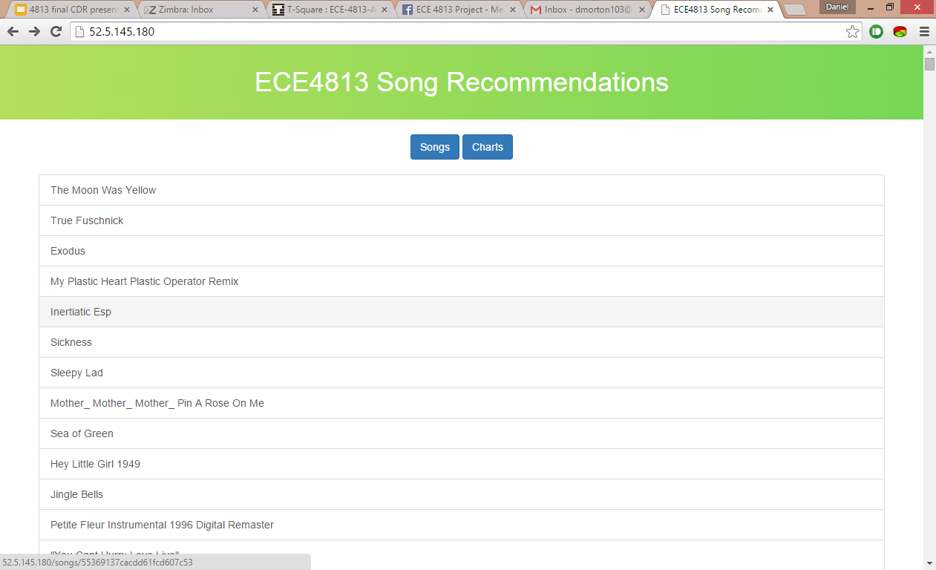
FRONTEND GUI

Slide 10
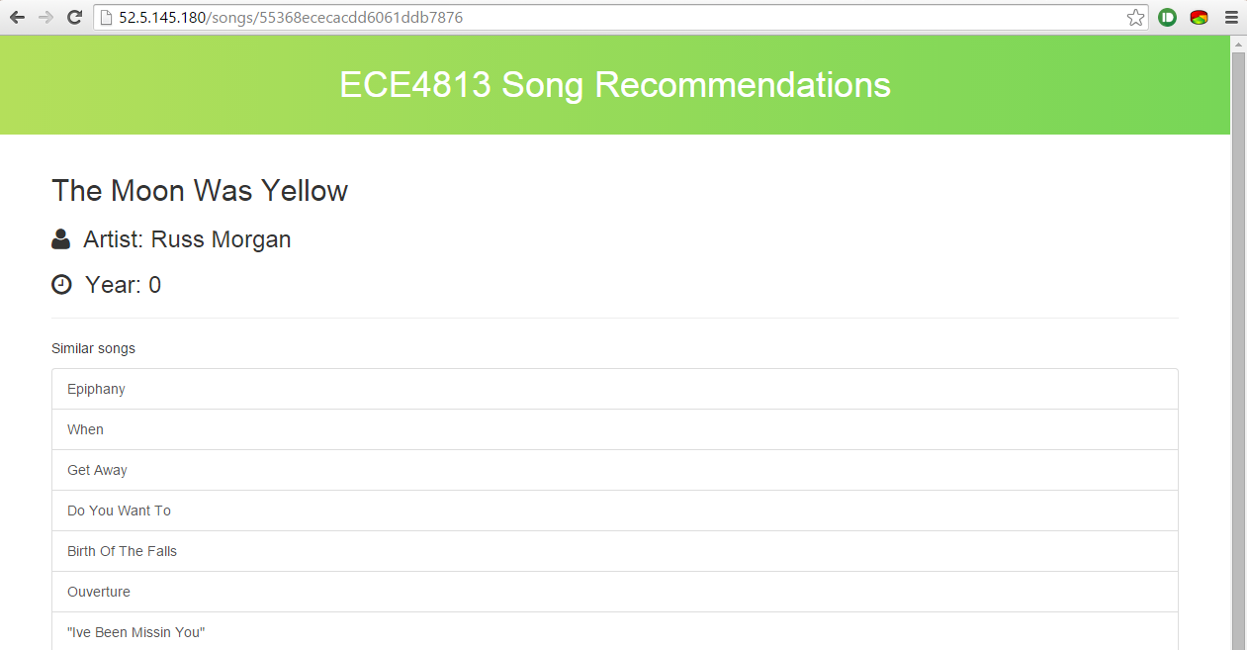
FRONTEND GUI

Slide 11
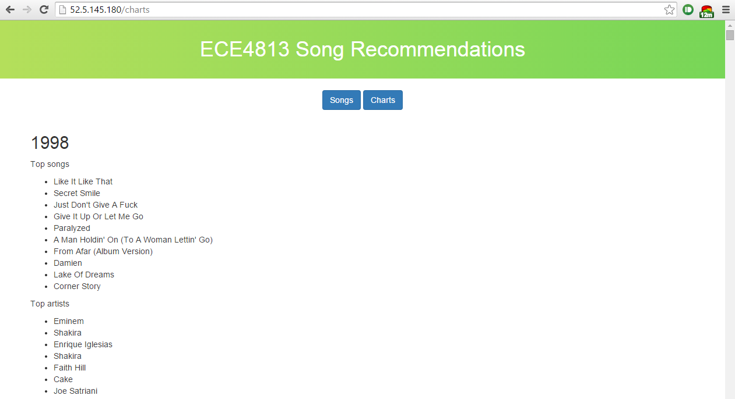
FRONTEND GUI

Slide 12
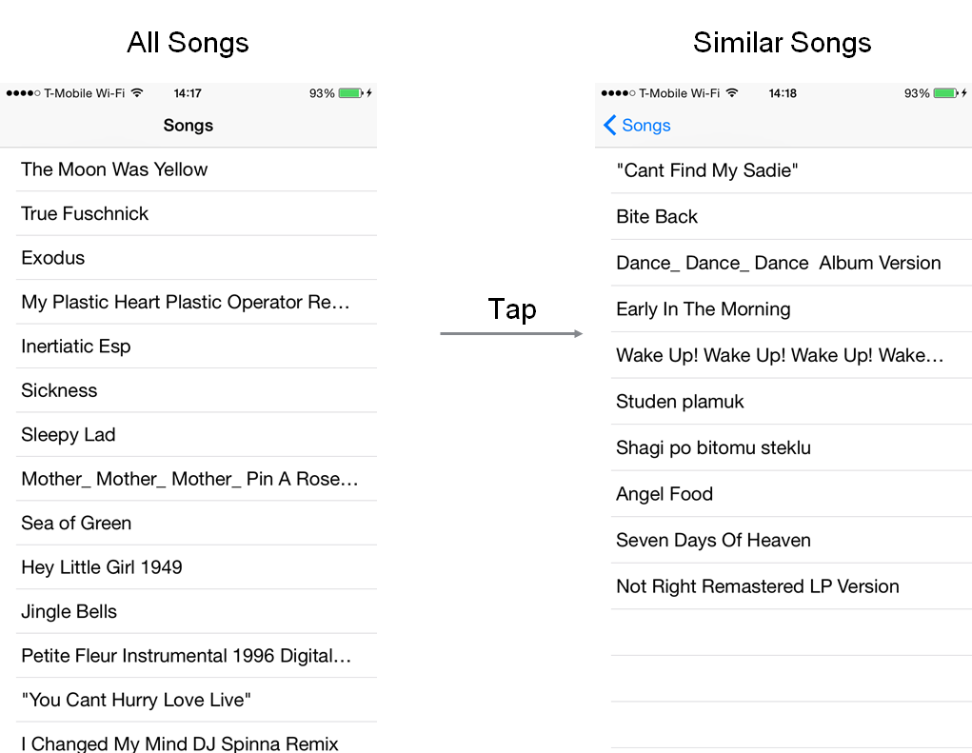
THIRD PARTY DEVELOPER DEMO

Slide 13
CHALLENGES
Selection of fields based on which clustering would be carried out
Saved the intermediate clustering information in RDD
Eventually had to save them in textfile
While reading the textfile back, for the later part of the program, had to perform parsing and data modification
Figured out Spark transformations for appropriate RDD formation
Sparks stop when the in-memory capacity gets full, so we had to launch a larger instance to process the larger dataset (1 million)
For more accurate recommendation, the time-dependent fields (float array) had to be taken into account

Slide 14
RESULTS
Million Song Dataset: Studied the structure and format of the dataset and identified the metadata we can use for the recommendation system
Apache Spark: Used Ambari Server to setup the Spark application to transform the data into suitable format to perform various analysis
Machine Learning: Used K-means clustering along with cosine similarity and Euclidean distance to recommend similar songs using Spark’s MLlib
MapReduce: Used the various transformations to obtain a list of top 10 artists and top 10 songs for the same year as the queried song.
Data storage: Used MongoDB to store the data generated by Spark. Used Node.js modules to integrate MongoDB data with front-end.
API: Created an API with use cases for song (by ID) and a view of the most popular songs/artists per year (the “charts” view).

